Slide 1
6. [Lab3] Implementing Front-end using Ionic framework
Training Workshop for IONIC framework

Slide 2
Objectives
Learn how to use implement Ionic application using template.
Understand the structure of Ionic project.
Learn the basic usage of Ionic framework.
Learn how to simulate Ionic project.

Slide 3
Contents
6.1 Simulating Ionic Template
6.2 Introducing Ionic Page Structure
6.2.1 HTML
6.2.2 SCSS
6.2.3 Typescript
6.3 Implementing Pages of IMM
6.3.1 Home Page
6.3.2 About-museum Page
6.3.3 Map Page
6.3.4 Reference Site
6.4 Testing Ionic project on Chrome

Slide 4


6.1 Simulating Ionic Template
To simulate Ionic template on chrome, open the template project folder.
Unzip ionic3API file in TutorialResources.
C:\desktop\ionic3API
Open the ionic3API folder on visual studio code.

Slide 5
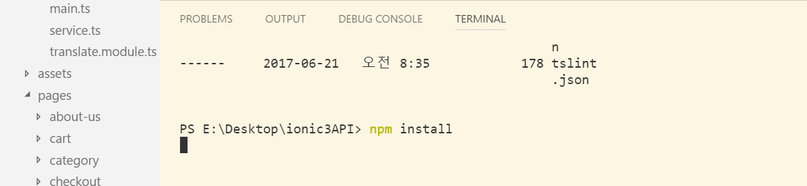
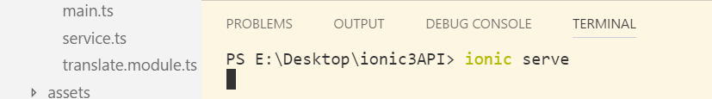
6.1 Simulating Ionic Template
Run npm install
Run ionic serve.

Slide 6
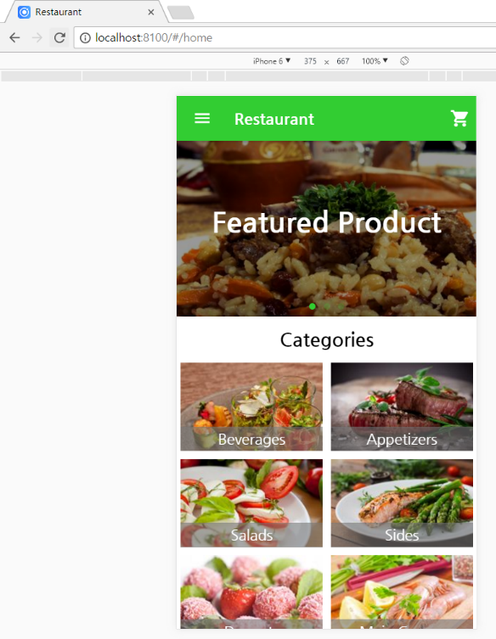
6.1 Simulating Ionic Template
This command will start a live-reload server for your project.
when pressing ctrl+shift+j, device mode for emulation is shown.

Slide 7
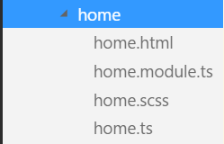
6.2 Introducing Ionic Page Structure
Ionic application consists of many pages.
When Ionic project is generated, Pages folder that contains all of the page components for application is created.
Each page component is made up of a class definition(.ts), a template(.html), and style definition(.scss).
(*We do not cover .module.ts file)

Slide 8
6.2 Introducing Ionic Page Structure
6.2.1 HTML
An HTML file defines the components that are displayed.
Components = traditional HTML tags + custom tags used to define the Ionic components.
All of the Ionic components have the prefix ion-, so they are easy to spot in the markup.
page.html
+
page.scss
+
page.ts
Ionic Page
(source: Mobile App Development with Ionic, Chris Griffith)

Slide 9
6.2 Introducing Ionic Page Structure
6.2.2 SCSS
CSS defined the visual definition of an Ionic application.
CSS is generated by Sass.
The screen’s .scss file is where you will define any-page specific CSS.
(source: Mobile App Development with Ionic, Chris Griffith)

Slide 10
6.2 Introducing Ionic Page Structure
6.2.3 TypeScript
TypeScript file where all the Angular/TypeScript code to control the interaction of this page will be written.
The file will define any code modules we need to import for our screen to function.
These usually would be components that we might need to programmatically interact with or Angular modules that offer needed functions (like making an HTTP requests).
(source: Mobile App Development with Ionic, Chris Griffith)

Slide 11


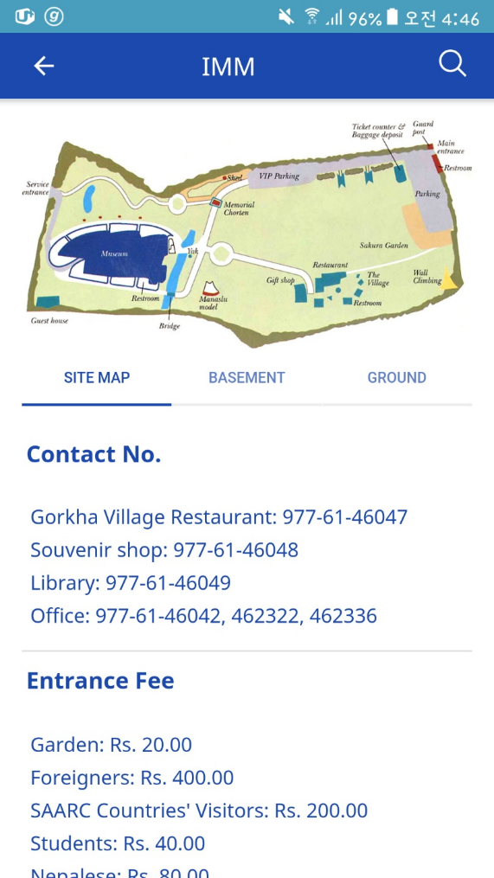
6.3 Implementing Pages of IMM
Next part will show how to implement Home page, About-museum page, and Map page.

Slide 12
6.3 Implementing Pages of IMM
6.3.1 Home Page
Setting root page.
We will use Home page of template.
The page first displayed when this application is loaded should be home page, so change code in app.component.ts to set rootPage as Home page.

Slide 13
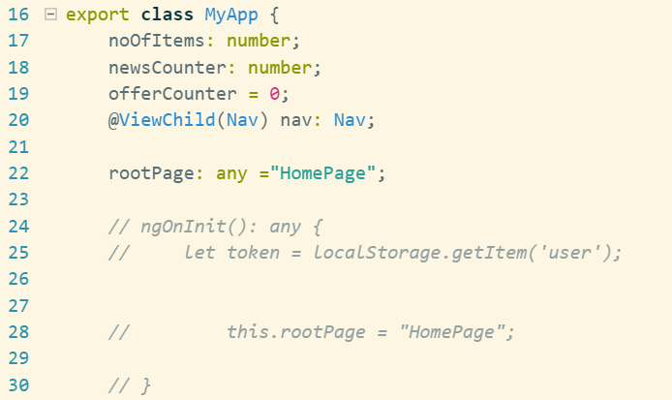
6.3 Implementing Pages of IMM
6.3.1 Home Page
Setting root page.
Change app.components.ts as follow.
src/app/app.component.ts

Slide 14
6.3 Implementing Pages of IMM
6.3.1 Home Page
Nav Bar
Navbar acts as the navigational toolbar.
Navbars must be placed within an <ion-header> in order for them to be placed above the content.

Slide 15
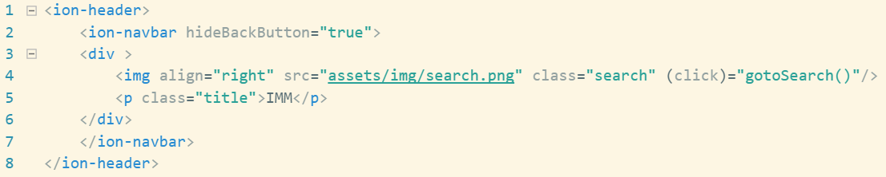
6.3 Implementing Pages of IMM
6.3.1 Home Page
Nav Bar
Home page is the starting page, so back button should be hided, and to use custom image for search icon, put image into assets/img folder.
assets folder : You can store any static assets that your application may want to make use of, like images and JSON files.
src/pages/home/home.html

Slide 16
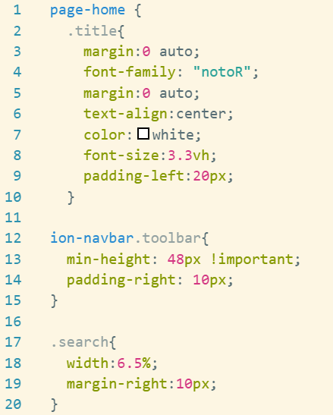
6.3 Implementing Pages of IMM
6.3.1 Home Page
Nav Bar
Make css classes to apply style at each component.
src/pages/home.scss

Slide 17
6.3 Implementing Pages of IMM
6.3.1 Home Page
Setting custom font
We want to use custom font for “IMM” in the middle of nav bar.
To use custom fonts, first create src/assets/fonts folder and put font files in .ttf format into src/assets/fonts folder.
.ttf file is in TutorialResource/home page.

Slide 18
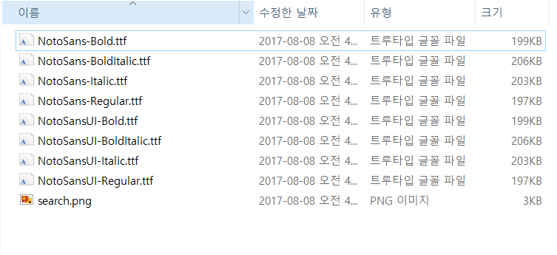
6.3 Implementing Pages of IMM
6.3.1 Home Page
Setting custom font
TutorialResource/home page

Slide 19
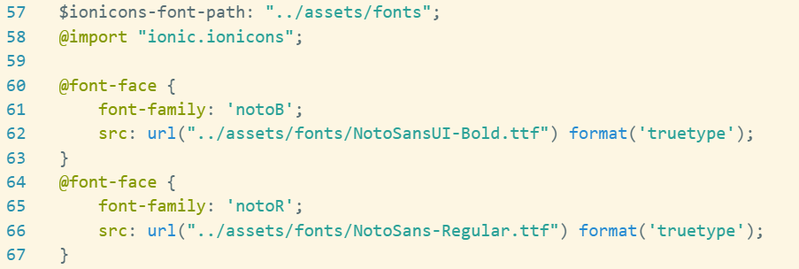
6.3 Implementing Pages of IMM
6.3.1 Home Page
Setting custom font
Add variable in variable.scss
theme/variable.scss

Slide 20
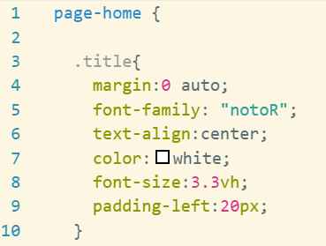
6.3 Implementing Pages of IMM
6.3.1 Home Page
Setting custom font
Use custom font as setting font-family in .scss file.
src/pages/home.scss

Slide 21
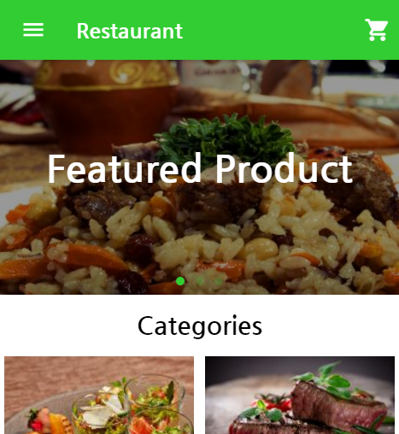
6.3 Implementing Pages of IMM
6.3.1 Home Page
Retrieving data from server for sliding images
Images in <ion-slides> should be changed and text on the image should be deleted.
To change images, we will load the URL of the images from server.

Slide 22
6.3 Implementing Pages of IMM
6.3.1 Home Page
Retrieving data from server for sliding images
To bring data from server, call REST API. Use below API that returns the URL of main images.
URL | Method | Success Response
/main | GET | Code : 200 Content : [{img_path": "http://ec2-34-224-40-186.compute-1.amazonaws.com:3000/public/main_img_1.png"}, {"img_path": "http://ec2-34-224-40-186.compute-1.amazonaws.com:3000/public/main_img_2.png"}, {"img_path": "http://ec2-34-224-40-186.compute-1.amazonaws.com:3000/public/main_img_3.png"}]

Slide 23

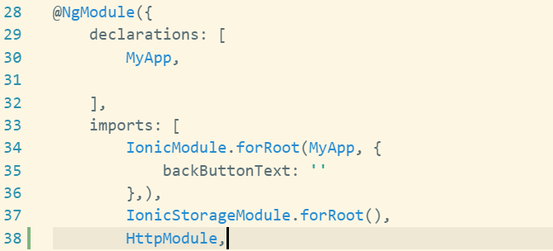
6.3 Implementing Pages of IMM
6.3.1 Home Page
Retrieving data from server for sliding images
Import Http and HttpModule angular module in app.module.ts.
* Skip this step. In app.module.ts of this template, Http module is already imported.
app.module.ts

Slide 24


6.3 Implementing Pages of IMM
6.3.1 Home Page
Retrieving data from server for sliding images
To read JSON from server, we will use the Http service which is provided by Angular, and allows you to make HTTP requests.
Import Http and HttpModule in home.ts and inject into the constructor.
src/pages/home.ts

Slide 25
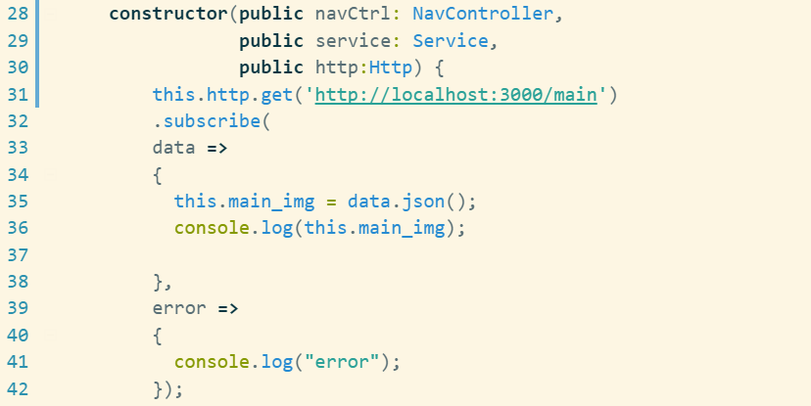
6.3 Implementing Pages of IMM
6.3.1 Home Page
Retrieving data from server for sliding images
Get data in JSON format from server using get method and save it in the variable named main_img.
src/pages/home.ts

Slide 26
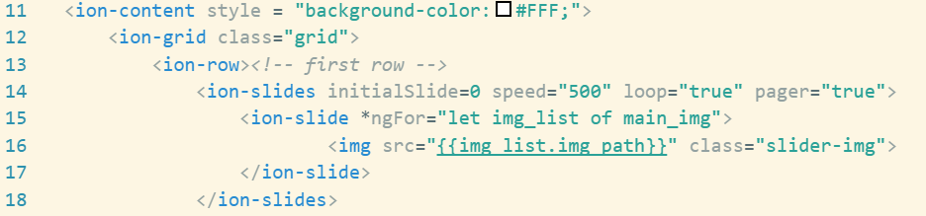
6.3 Implementing Pages of IMM
6.3.1 Home Page
Retrieving data from server for sliding images
We can use the ngFor directive which is supplied by Angular 2.
let creates a local variable img_list that we have in main_img array and this allows us to access.
We use img_list to grab the img_path of the current img_list.
src/pages/home.html

Slide 27
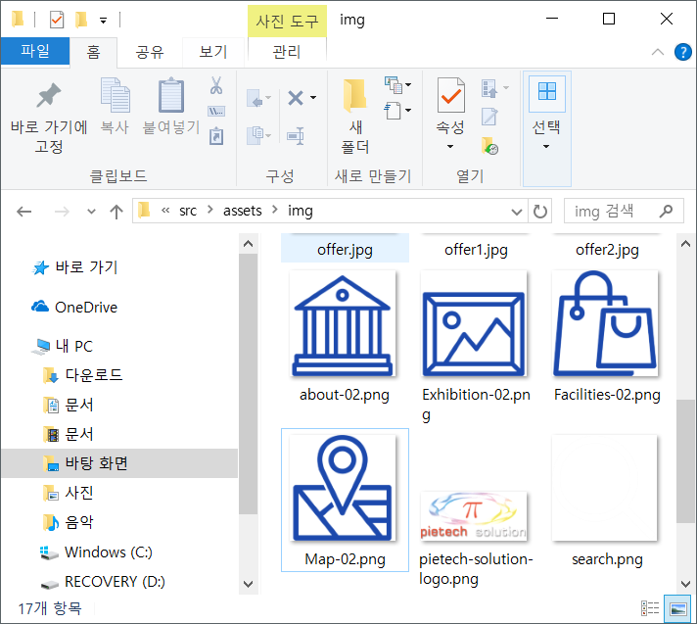
6.3 Implementing Pages of IMM
6.3.1 Home Page
Changing Item Images
Copy icon images into src/assets/img folder.
icon images are in TutorialResource/images

Slide 28
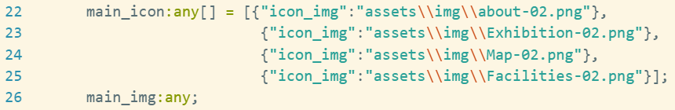
6.3 Implementing Pages of IMM
6.3.1 Home Page
Changing Item Images
Declare a variable which is array containing a image path.
home.ts

Slide 29
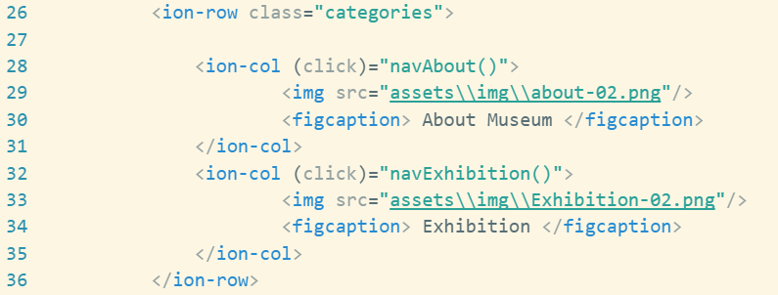
6.3 Implementing Pages of IMM
6.3.1 Home Page
Changing Item Images
Set two rows and two columns, and write image path.
Write text under the icons by using <figcaption>
home.html

Slide 30
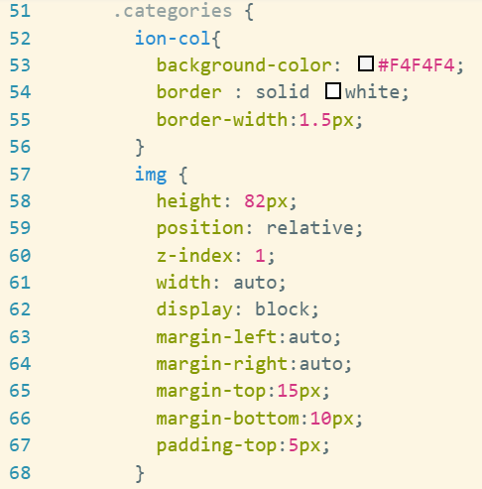
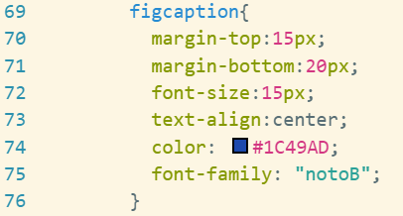
6.3 Implementing Pages of IMM
6.3.1 Home Page
Changing Item Images
Make css classes to apply style at each component.
home.scss

Slide 31

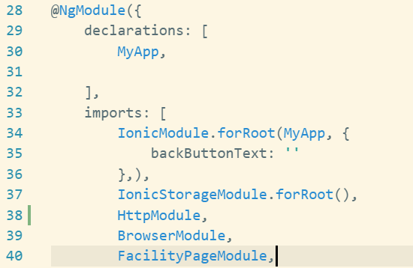
6.3 Implementing Pages of IMM
6.3.1 Home Page
Generating new page
New page module should be imported and added to ngModule in the app.module.ts
App.module.ts

Slide 32
6.3 Implementing Pages of IMM
6.3.1 Home Page
Page navigation
When click icons on home page screen, page should be changed. In Ionic, page navigation is implemented as pushing onto the navigation stack and popping them off.
NavContoller which is provided by ionic should be imported in Ionic applications.
Following steps will show how to navigate pages by pushing and popping.

Slide 33

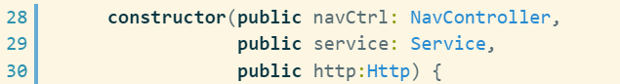
6.3 Implementing Pages of IMM
6.3.1 Home Page
Page navigation
NavController is the base class for navigation controller components.
Navcontroller should be imported in home.ts
home.ts

Slide 34
6.3 Implementing Pages of IMM
6.3.1 Home Page
Page navigation
Inject the NavContoller which helps us control navigation into constructor.
Import pages into home.ts
We use about-us page for about-museum page, news page for exhibition page, map page, facility page, and search page in home page.
Template application does not have map page, facility page, and search page, so we generate new pages.

Slide 35

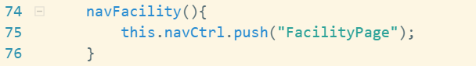
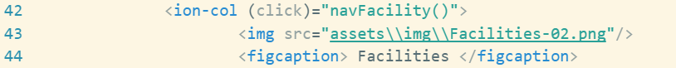
6.3 Implementing Pages of IMM
6.3.1 Home Page
Page navigation
Make functions which are called when click event occurs.
home.ts
home.html

Slide 36
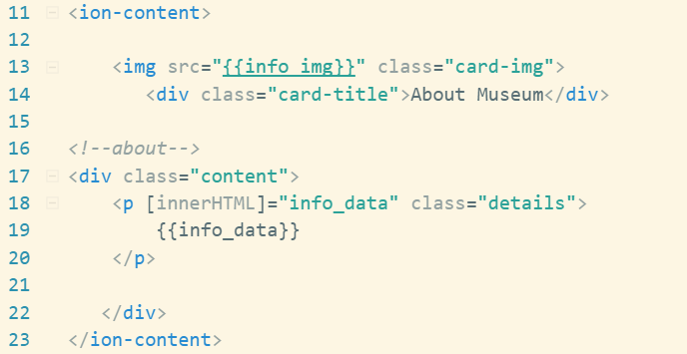
6.3 Implementing Pages of IMM
6.3.2 About-museum page
Construction page
We use about-us page of template for about-museum page that introduces museum.
Delete unnecessary code.
About-us.html

Slide 37
6.3 Implementing Pages of IMM
6.3.2 About-museum page
Retrieving Data
A description and a image path are stored in database, so page should load data from server.
To retrieve data from server, call REST API. Use below API.
URL | Method | Success Response
/museum | GET | Code : 200 Content example: { "info_img": "http://ec2-34-224-40-186.compute-1.amazonaws.com:3000/public/about_img.png", "info": "Many people in the world may not know much about the small country called Nepal, but they …” }

Slide 38
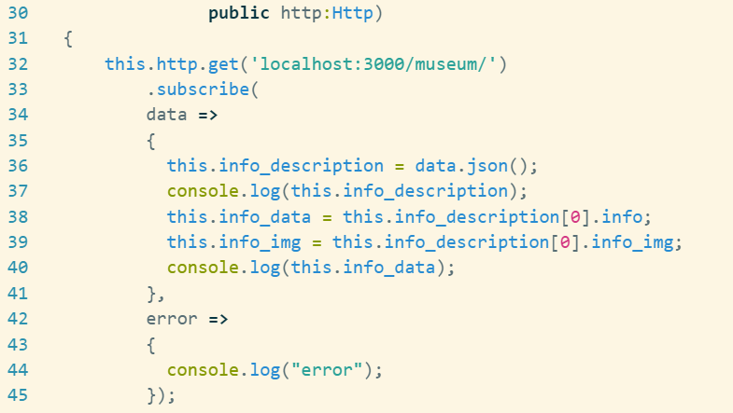
6.3 Implementing Pages of IMM
6.3.2 About-museum page
Retrieving Data
Get data in JSON format from server by using get method and save it in the variables.
about-us.ts

Slide 39

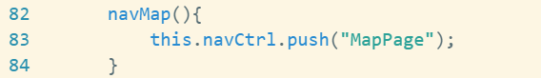
6.3 Implementing Pages of IMM
6.3.3 Map page
Using segment component
Generate new page for Map page.
Write navMap function to navigate Map page from Home page.
home.ts

Slide 40
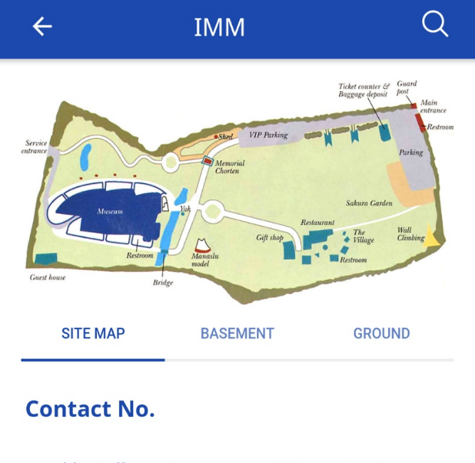
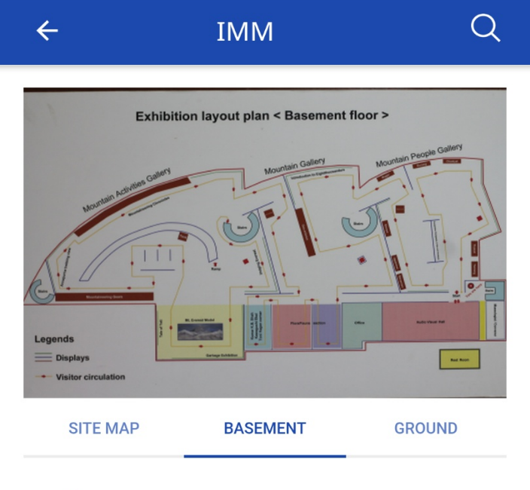
6.3 Implementing Pages of IMM
6.3.3 Map page
Using segment component
To change contents displayed on screen, we will use segment button which is a collection of buttons that are displayed in line. They can act as a filter, showing/hiding elements based on the segments value.

Slide 41
6.3 Implementing Pages of IMM
6.3.3 Map page
Retrieving Data
Use below API
URL | Method | Success Response
/maps | GET | Code : 200 Content : [{"map_img": “~/public/ground.jpg", "map_name": "GROUND”}, {"map_img": “~/public/sitemap.jpg", "map_name": "SITE MAP" }, {"map_img": “~/public/basement.jpg", "map_name": "UNDERGROUND"}]
/maps/info | GET | Code : 200 Content : [{"map_name": "SITE MAP", "info": "Gorkha Village Restaurant: 977-61-46047", "info_type": "contact"}, {"map_name": "SITE MAP", "info": "Nepalese: Rs. 80.00", "info_type": "fee“}, …]

Slide 42
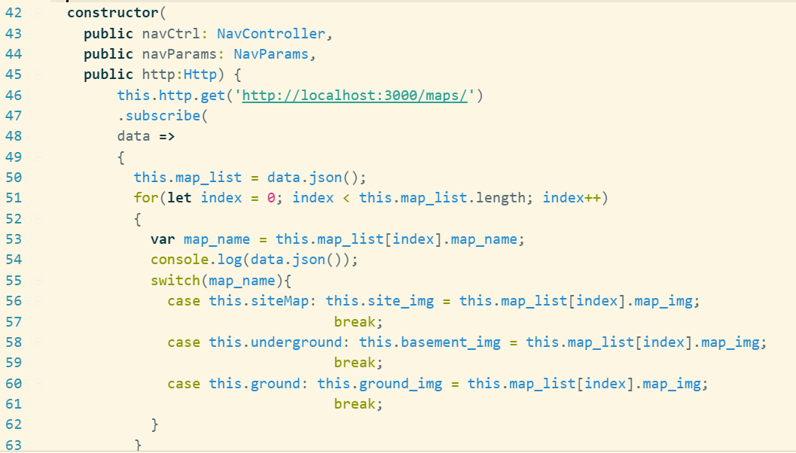
6.3 Implementing Pages of IMM
6.3.3 Map page
Retrieving Data
Write code to store data in variable.
map.ts

Slide 43
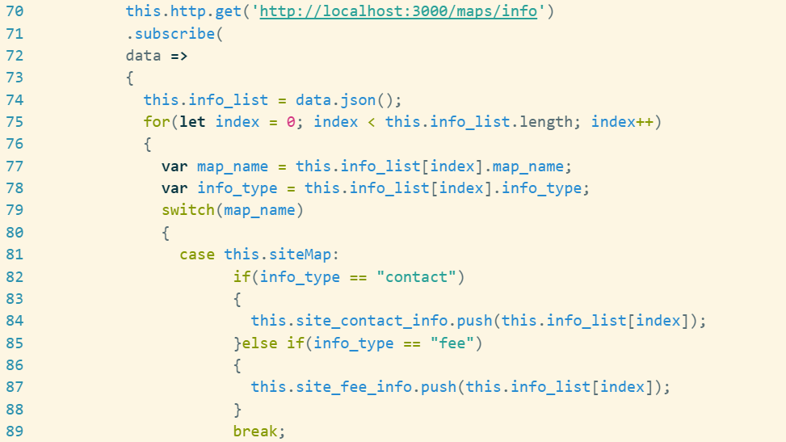
6.3 Implementing Pages of IMM
6.3.3 Map page
Retrieving Data
map.ts

Slide 44
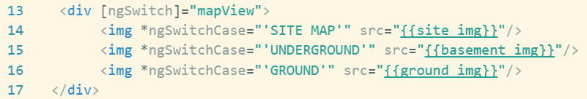
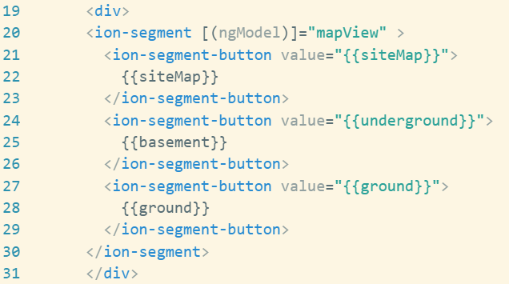
6.3 Implementing Pages of IMM
6.3.3 Map page
Using segment component
We use segment button component in map page.
map.html

Slide 45
6.3 Implementing Pages of IMM
6.3.3 Map page
Using segment component
NgSwitch stamps out nested views when their match expression value matches the value of the switch expression.
you define a container element (where you place the directive with a switch expression on the [ngSwitch]="..." attribute)
Elements within NgSwitch but outside of a NgSwitchCase or NgSwitchDefault directives will be preserved at the location.

Slide 46
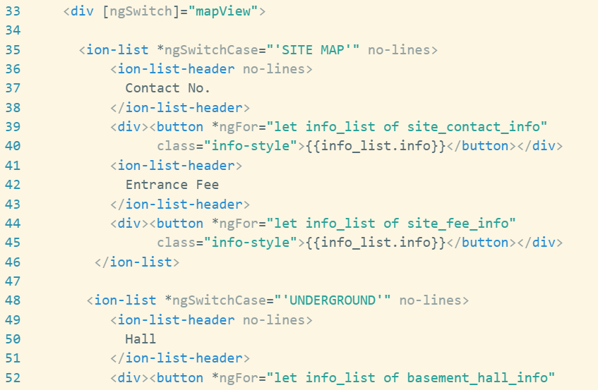
6.3 Implementing Pages of IMM
6.3.3 Map page
Using segment component
map.html

Slide 47
6.3 Implementing Pages of IMM
6.3.4 Reference Site
Ionic API doc : https://ionicframework.com/docs/api/
Ionic component doc : https://ionicframework.com/docs/components/
Ionic apps are made of components
Ionic component doc introduces each components and basic usage with demo source.

Slide 48
6.4 Testing Ionic Project on Chrome
Solving cross-origin resource sharing problem
When you run ionic serve at this time, console in Chrome shows you “No 'Access-Control-Allow-Origin' header is present on the requested resource” error.
To solve this problem, cross-origin resource sharing should be enabled and we will use Allow-Control-Allow-Origin Chrome extension for this.

Slide 49
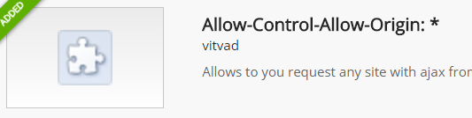
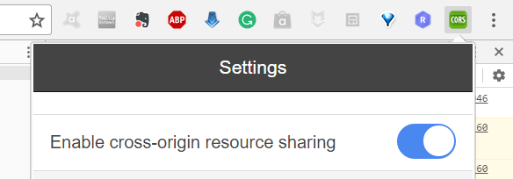
6.4 Testing Ionic Project on Chrome
Solving cross-origin resource sharing problem
Add Chrome extension program “Allow-Control-Allow-Origin”.
Enable cross-origin resource sharing.

Slide 50
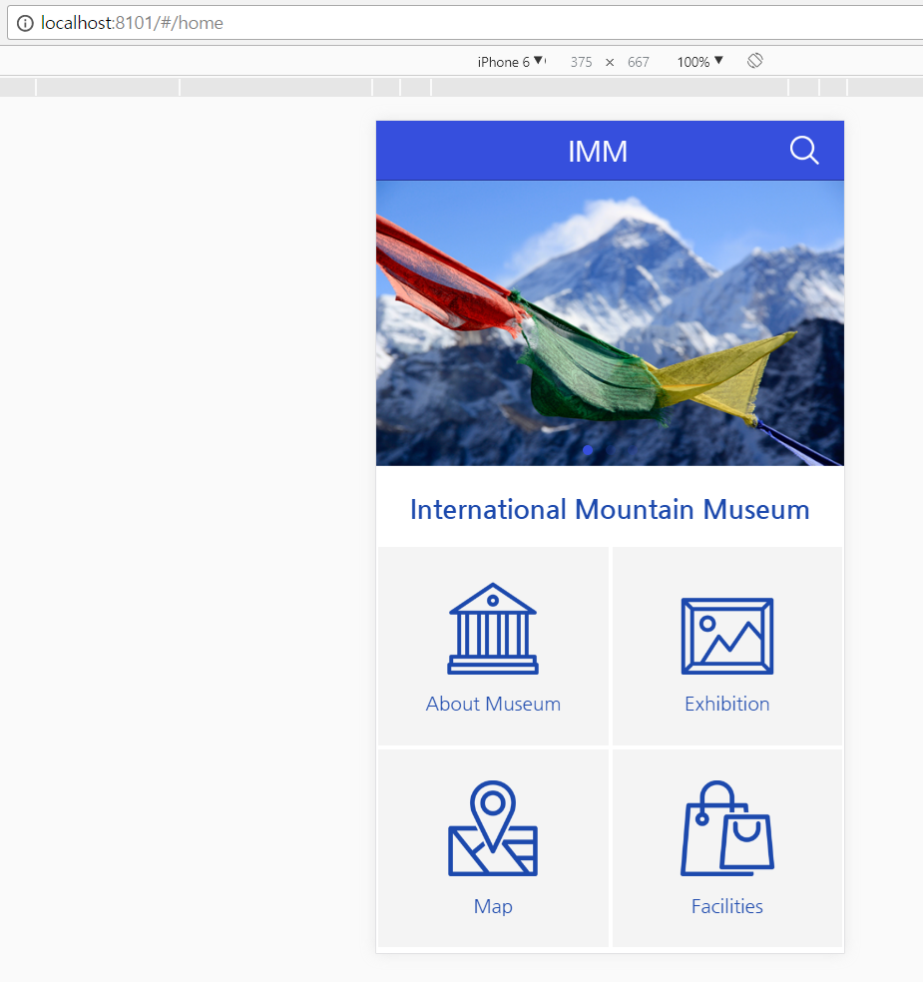
6.4 Testing Ionic Project on Chrome
Solving cross-origin resource sharing problem
Now when ionic serve is running, browser shows this screen.

Slide 51
Summary
We simulated template on Chrome.
We implemented Home page, About-museum page, Map page.
Generating new page using Ionic CLI
Load data from server using http module
Using Ionic components
We tested application on Chrome.

